Slide 1
Good Coding Habits

Slide 2
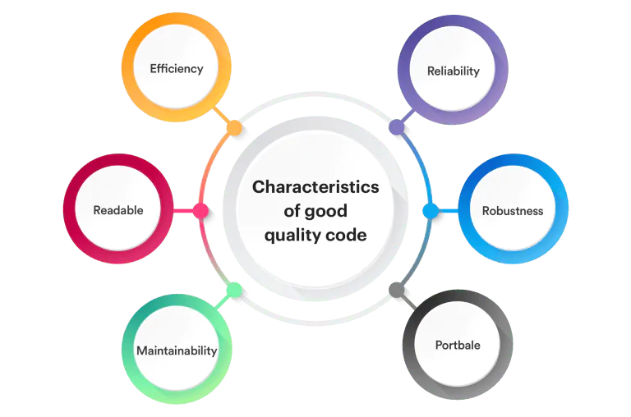
Characteristics of good code
Good code is characterized by several key qualities that make it reliable, efficient, and easy to understand and maintain.
These include functionality, readability, testability, maintainability, and efficiency.
Good code also adheres to good coding practices, which often include clear naming conventions, proper commenting, and a well-structured design

Slide 3
Characteristics of good code
Key Characteristics of Good Code:
  Functionality: The code fulfills its intended purpose and produces the correct output for the given input. It should also handle failure modes gracefully, providing informative error messages rather than silently failing, according to a post on Quora.
  Readability: Good code is easy to understand and follow, both for the original author and for other developers who may need to work with it in the future. This includes using clear and descriptive variable and function names, proper indentation, and helpful comments to explain complex logic.
  Testability: Good code is designed in a way that makes it easy to write and run automated tests. This allows developers to verify that the code works as expected and to quickly identify and fix any issues.
  Maintainability: Good code is easy to modify and extend without introducing new bugs or breaking existing functionality. This is often achieved through modular design, separation of concerns, and a clear, well-defined structure.

Slide 4
Characteristics of good code
Key Characteristics of Good Code: (Cont.)
  Efficiency: Good code minimizes resource consumption (like CPU time and memory) and runs in a reasonable time, especially for large inputs or high loads.
  Adherence to Coding Standards: Following established coding conventions and best practices helps to ensure consistency and predictability in the code, making it easier to understand and maintain.
  Cleanliness: Good code is often described as "clean," meaning it is simple, straightforward, and avoids unnecessary complexity. This often involves using descriptive variable names, avoiding code duplication, and keeping functions and classes focused on a single responsibility.
  Modularity: Good code is organized into smaller, reusable components (functions, classes, modules) that can be easily combined and reused in different parts of the application.
  Scalability: Good code is designed to handle increasing amounts of data or traffic without significant performance degradation. This often involves choosing appropriate data structures and algorithms and optimizing the code for performance.

Slide 5
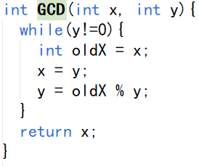
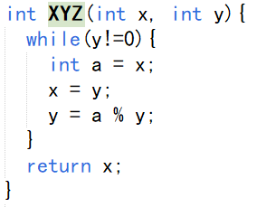
Good code is readable
You prefer which version of code?

Slide 6
Good code is reliable
Reliable code consistently performs its intended function correctly and predictably, even under various conditions, including unexpected inputs and potential errors.
It is characterized by its ability to function without failure, handle errors gracefully, and maintain consistent performance.
Ultimately, reliable code minimizes errors, handles unexpected situations, and maintains performance, ensuring a stable and trustworthy software experience.

Slide 7
Good code is hard to misuse
To write code that is difficult to misuse, focus on clarity, encapsulation, and compile-time checks.
Use descriptive names, keep functions simple, and strive for readability.
Hide implementation details, utilize the compiler to catch errors, and prioritize correctness and maintainability over short-term efficiency gains.

Slide 8
Good code is hard to misuse
Focus on Clarity and Readability:
  Meaningful Names: Use descriptive names for variables, functions, and classes that clearly convey their purpose. Avoid single-letter variable names and nonsensical function names.
  Simple Functions: Break down complex tasks into smaller, well-defined functions. Each function should ideally perform a single, focused task.
  Readability: Ensure your code is well-formatted with proper indentation and spacing. Consistent formatting makes the code easier to understand and follow.
  Comments (Use Judiciously): While excessive comments can be detrimental, well-placed comments can clarify complex logic or explain the rationale behind certain decisions.

Slide 9
Good code is hard to misuse
Emphasize Encapsulation and Abstraction:
  Hide Implementation Details: Make use of access modifiers (e.g., private, protected) to control access to class members. Hide internal data structures and implementation details from the outside world.
  Abstract Classes/Interfaces: Use abstract classes or interfaces to define contracts and restrict the creation of unnecessary objects. This helps guide users towards correct usage.
  Parameterized Constructors: Employ parameterized constructors to enforce specific initialization requirements, preventing misuse during object creation.

Slide 10
Good code is hard to misuse
Leverage the Compiler:
  Compile-Time Checks: Take advantage of the compiler's ability to catch errors during compilation. Utilize strong typing and generics to eliminate runtime type errors and ensure code correctness.
  Static Analysis: Use static analysis tools to identify potential issues like null pointer dereferences, unused variables, and code style violations before runtime.

Slide 11
Good code is hard to misuse
Design for Ease of Use (but also hard to misuse):
  Write Tests: Write comprehensive unit tests to verify the correctness of your code and ensure that it behaves as expected. Tests also serve as documentation and help catch regressions during future changes.
  Refactor Regularly: Refactor your code to improve its structure, readability, and maintainability. Remove redundant code and simplify complex logic.
  Don't Trust Everything: Assume that external inputs and the environment might be malicious or unreliable. Implement appropriate error handling and validation to prevent misuse.

Slide 12
Good code is hard to misuse
Prioritize Correctness and Maintainability:
  Simple Interfaces: Make your code's interface intuitive and easy to understand. Users should be able to grasp the basic functionality quickly.
  Provide Feedback: Offer clear error messages and helpful feedback to users when they make mistakes. This can prevent them from becoming frustrated and resorting to workarounds.
  Consider the "Happy Path": Focus on making the common use cases simple and straightforward, while making it difficult to stray from that path.
By combining these strategies, you can create code that is not only easy to use but also robust and resistant to misuse.

Slide 13
Good code is modular
Writing modular code involves breaking down a program into independent, self-contained units, or "modules," each responsible for a specific, well-defined task.
This approach enhances code organization, reusability, maintainability, and testability.

Slide 14
Good code is modular
Key principles and techniques for writing modular code:
  Single Responsibility Principle (SRP): Each module, function, or class should have one, and only one, reason to change. This means it should be responsible for a single, distinct piece of functionality.
  Encapsulation and Information Hiding: Modules should hide their internal implementation details and expose only what is necessary for other modules to interact with them through clear interfaces. This minimizes dependencies and allows for changes within a module without affecting others.
  Low Coupling: Minimize the interdependencies between modules. Modules should be as independent as possible, reducing the impact of changes in one module on others.
  High Cohesion: The elements within a module should be highly related and work together to achieve a single purpose. A cohesive module focuses on a specific set of functionalities.
  Abstraction: Define clear levels of abstraction. Functions and classes should abstract away complex details, presenting a simpler, higher-level interface to the user of the module.

Slide 15
Good code is modular
Key principles and techniques for writing modular code: (Cont.)
  Reusability: Design modules to be easily reusable in different parts of the same application or even in other projects. This often involves creating generic functions or classes that can be adapted to various contexts.
  Clear Naming Conventions: Use meaningful and consistent names for modules, functions, variables, and classes to improve readability and understanding.
  Documentation: Document the purpose, inputs, outputs, and usage of each module and its components. This is crucial for understanding and maintaining modular code.
  Testing: Design modules with testability in mind. Unit tests can help ensure that each module functions correctly in isolation, which also encourages a modular design.
  Refactoring: Regularly review and refactor code to improve its modularity. This might involve extracting common logic into new functions, breaking down large classes, or reorganizing modules.

Slide 16
Good code is reusable
Yes, good code is designed to be reusable across different contexts with minimal modifications.
This practice, known as code reuse, offers numerous benefits, including time savings, reduced errors, and improved code maintainability.
Reusing existing code also allows developers to focus on new features and functionality rather than rewriting existing logic.

Slide 17
Good code is reusable
Here's why code reusability is important:
  Time and Effort Savings: Writing code from scratch for every project or feature is inefficient. Reusing existing, well-tested code significantly reduces development time and effort.
  Reduced Errors and Bugs: Code that has been reused multiple times is likely to have been tested and debugged, leading to fewer errors in new applications.
  Improved Consistency: Reusing code helps ensure consistency across different parts of an application or across multiple applications, which is crucial for maintainability and user experience.
  Increased Productivity: When developers can reuse code, they can focus on more complex and innovative tasks, boosting overall productivity.
  Easier Maintenance: If a bug is found in a reusable component, fixing it in one place can resolve the issue across all instances where that component is used.
  Scalability: Reusable components can be easily incorporated into larger systems, making it easier to scale applications and services.

Slide 18
Clean Code
Clean code is software code that is well-structured, easy to read, understand, and modify, and it adheres to established best practices and conventions.
It prioritizes clarity and maintainability over complex or clever solutions, making it easier for developers to collaborate, debug, and extend the codebase.

Slide 19
Clean Code
Key Characteristics of Clean Code:
  Readability: Clean code is easy to understand at a glance. It uses clear and meaningful names for variables, functions, and classes, avoiding jargon and overly complex logic.
  Maintainability: Clean code is designed to be easily modified and updated. This is achieved through modularity, clear separation of concerns, and consistent coding style.
  Testability: Clean code is structured in a way that makes it easy to write unit tests and other forms of testing, ensuring that changes don't introduce new bugs.
  Efficiency: While readability is prioritized, clean code is also efficient. It avoids unnecessary complexity and redundancy, ensuring that the code performs well.
  Conventions: Clean code adheres to established coding conventions and best practices, which helps to ensure consistency and makes it easier for multiple developers to work on the same codebase.
  Expressiveness: Clean code clearly communicates the intent of the code to other developers. It should be easy to understand what the code is doing without needing to dive into the implementation details.

Slide 20
Why Clean Code?
Benefits of Writing Clean Code:
  Improved Collaboration: When code is clean, it's easier for multiple developers to work together on a project, understand each other's work, and contribute effectively.
  Reduced Development Time: Clean code is easier to debug and modify, which can significantly reduce the time it takes to fix bugs and add new features.
  Lower Maintenance Costs: Clean code is easier to maintain over the long term, reducing the cost of maintaining and updating the software.
  Increased Code Quality: Clean code is more reliable, robust, and less prone to errors, leading to higher quality software.
In essence, clean code is about writing code that is not only functional but also a pleasure to read and work with. It's an investment in the long-term health and maintainability of the software project.

Slide 21
Some principles of Clean Code
Clean code prioritizes readability, maintainability, and collaboration by emphasizing clear, concise, and well-structured code.
Key principles include using meaningful names, writing small functions, avoiding repetition, and maintaining consistency in formatting and naming conventions.
Other important aspects involve writing self-documenting code, handling errors properly, and ensuring code is testable.

Slide 22
Some principles of Clean Code
Readability and Clarity:
  Meaningful Names: Use descriptive names for variables, functions, and classes that clearly indicate their purpose and intent.
  Small Functions: Break down complex tasks into smaller, focused functions that perform a single, well-defined action.
  Clear and Expressive Code: Write code that reads like prose, making it easy to understand the logic and flow.
  Comments: Use comments sparingly to explain why the code does something, not what it does. Self-documenting code should minimize the need for excessive comments.
  Consistency: Maintain consistent formatting, indentation, and naming conventions throughout the codebase.
  Follow Established Code Writing Standard: At least use the standard imposed by your project team.

Slide 23
Some principles of Clean Code
Maintainability:
  DRY (Don't Repeat Yourself): Avoid code duplication by extracting common logic into reusable components.
  Single Responsibility Principle (SRP): Ensure each class or module has a single, well-defined responsibility.
  Modularity: Break down the code into smaller, independent modules that can be easily reused and modified.
  KISS (Keep It Simple, Stupid): Avoid unnecessary complexity and prioritize simplicity and clarity.
  YAGNI (You Ain't Gonna Need It): Avoid implementing features that are not currently needed, as they can add unnecessary complexity and maintenance overhead.

Slide 24
Some principles of Clean Code
Testability:
  Testable Code: Write code that is easy to test, with clear separation of concerns and well-defined interfaces.
  Error Handling: Implement robust error handling mechanisms to prevent unexpected behavior and make debugging easier.
  Unit Tests: Write comprehensive unit tests to verify the correctness of individual components and functions.

Slide 25
Some principles of Clean Code
Other Important Considerations:
  Code Review: Engage in code reviews to identify potential issues and improve code quality.
  Refactoring: Regularly refactor the code to improve its structure, readability, and maintainability.
  Abstraction: Hide implementation details and expose a simple interface for users of the code.
  Boy Scout Rule: Leave the code cleaner than you found it, always striving for continuous improvement.
By following these principles, developers can create codebases that are easier to understand, maintain, and collaborate on, leading to more efficient and reliable software.

Slide 26
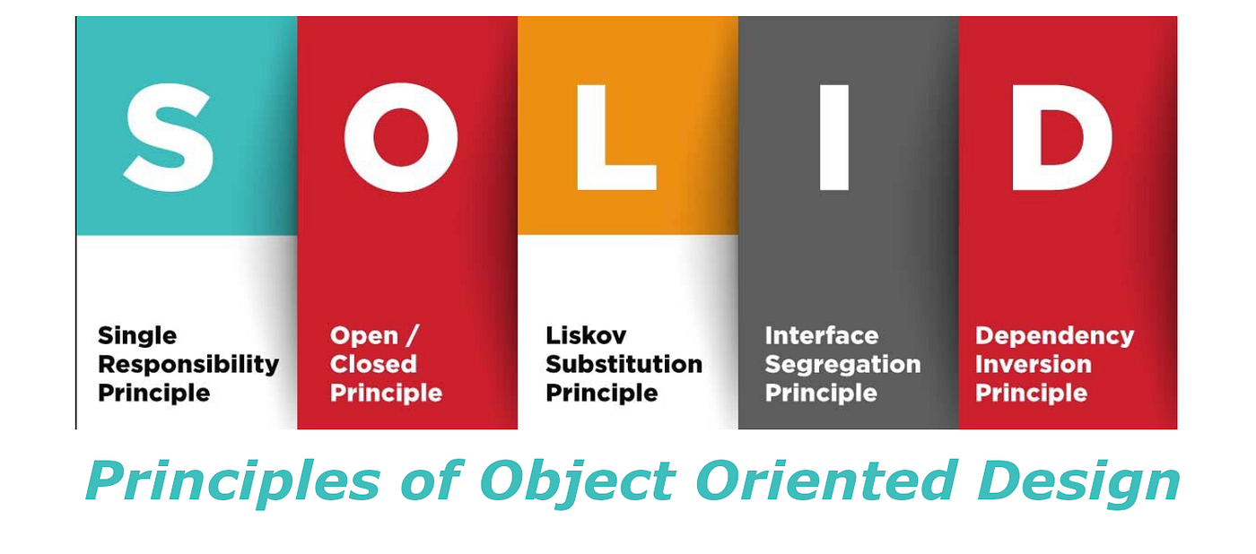
Write SOLID code
SOLID code refers to a set of five design principles that aim to make software more understandable, flexible, and maintainable.
These principles, collectively known as SOLID, are:
  Single Responsibility
  Open/Closed
  Liskov Substitution
  Interface Segregation, and
  Dependency Inversion.

Slide 27
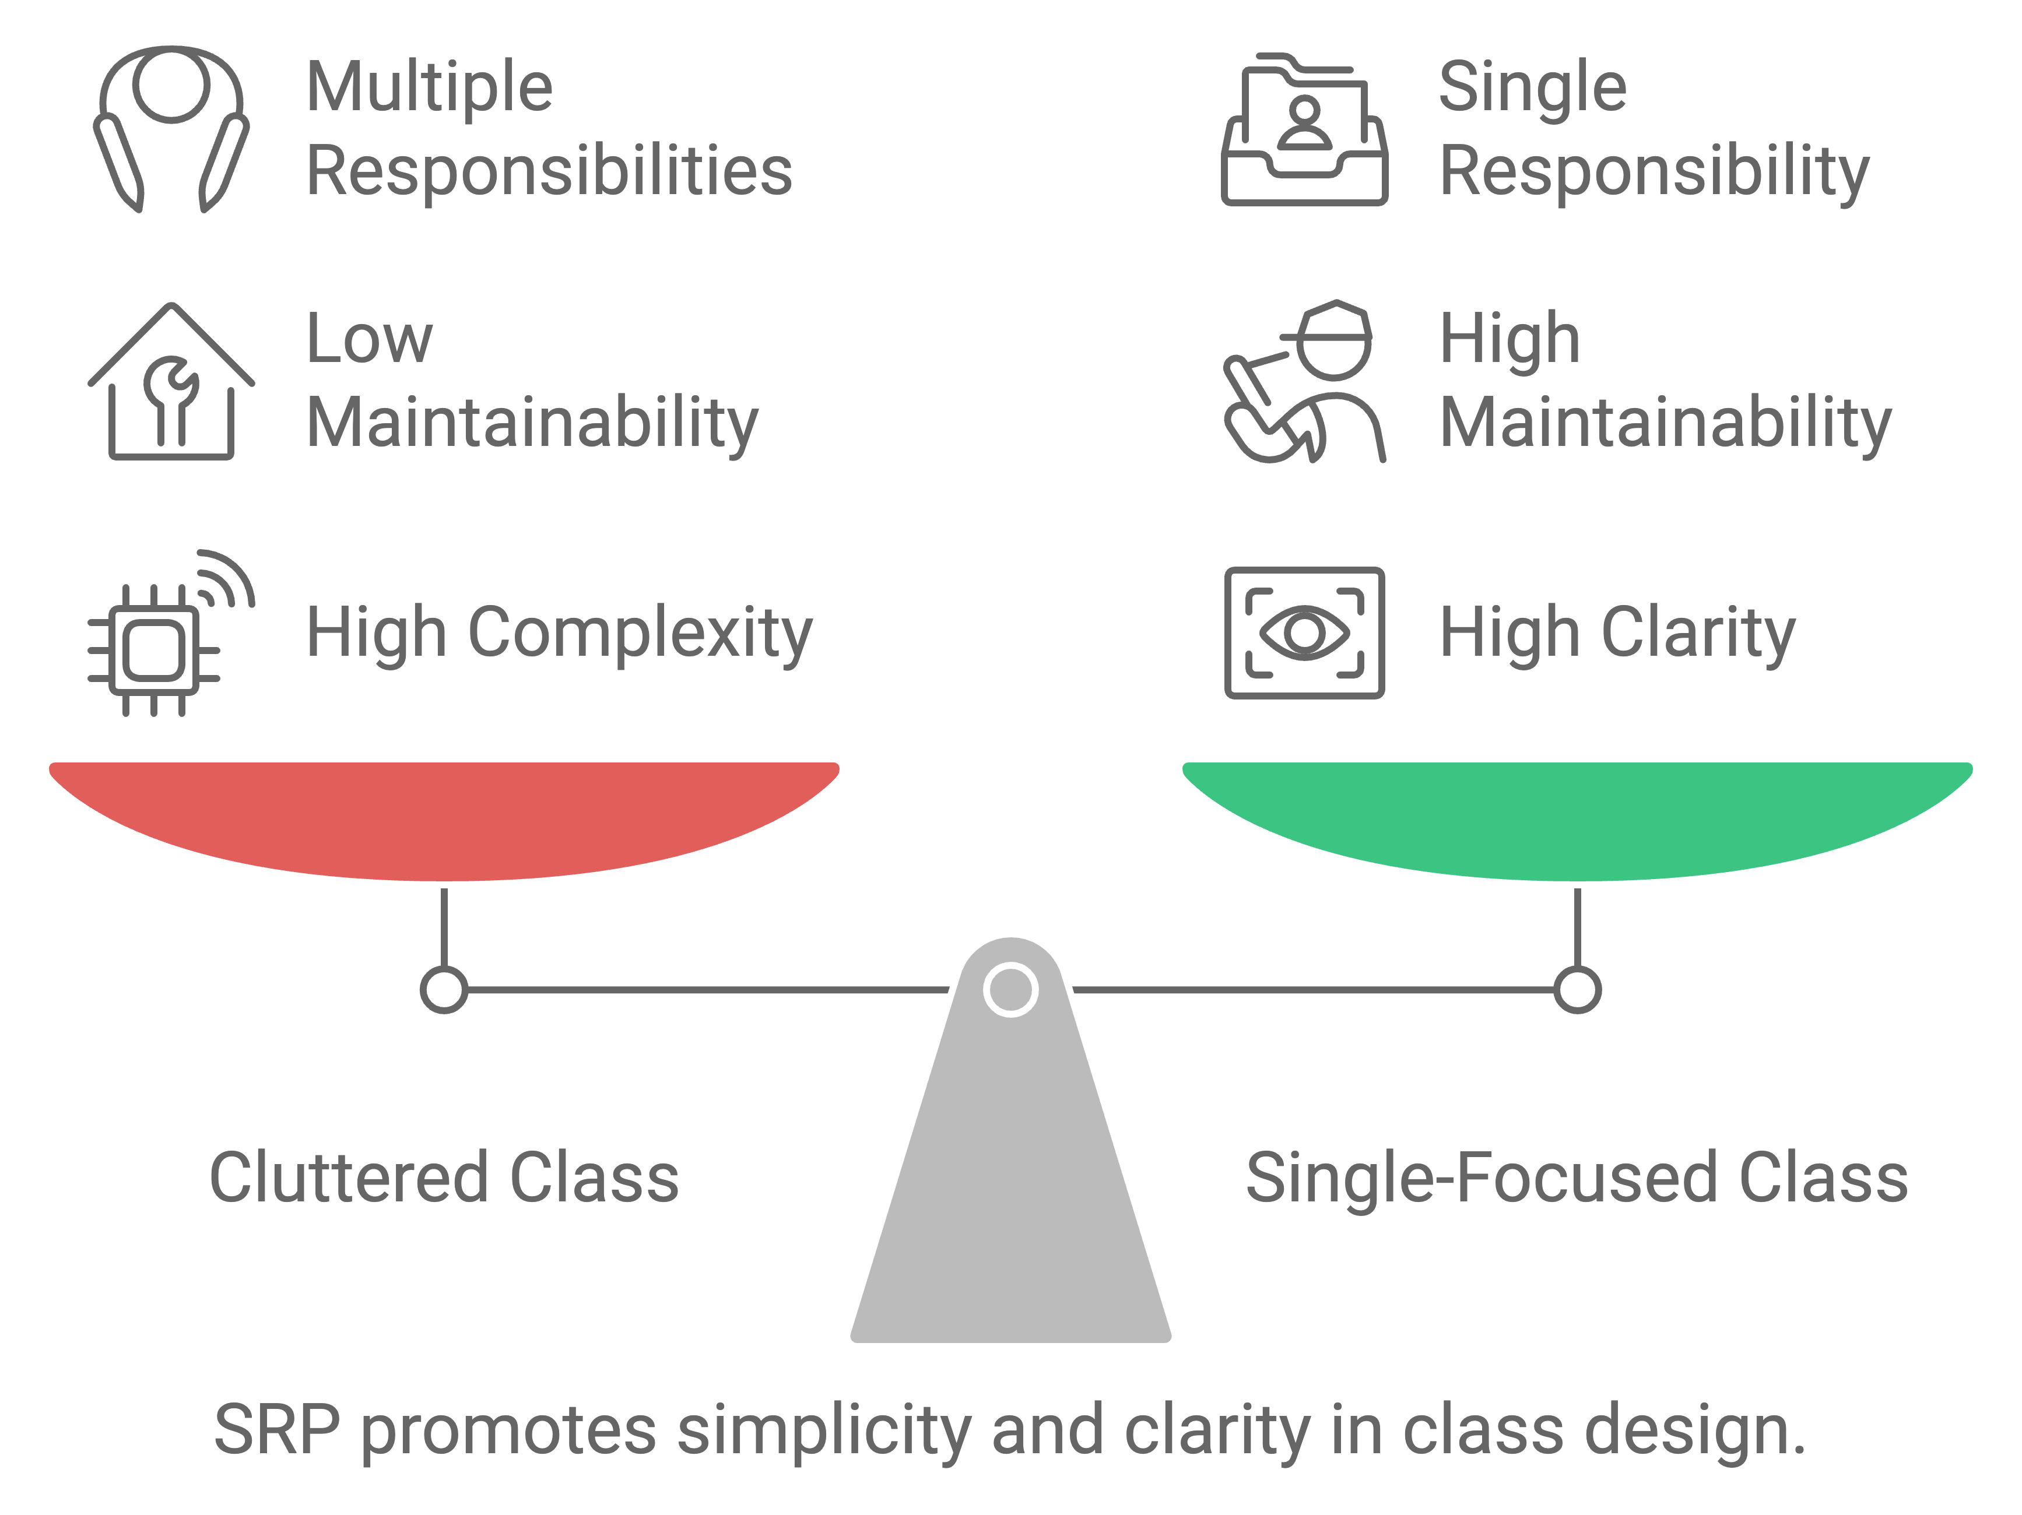
Single responsibility principle
Here's a breakdown of each principle and how to apply them:
Single Responsibility Principle (SRP): A class should have one, and only one, reason to change. This means each class should have a single responsibility, a single job or task.
  How to write SOLID code with SRP:
    Identify Responsibilities: Break down complex classes into smaller, more focused classes with distinct responsibilities.

Slide 28
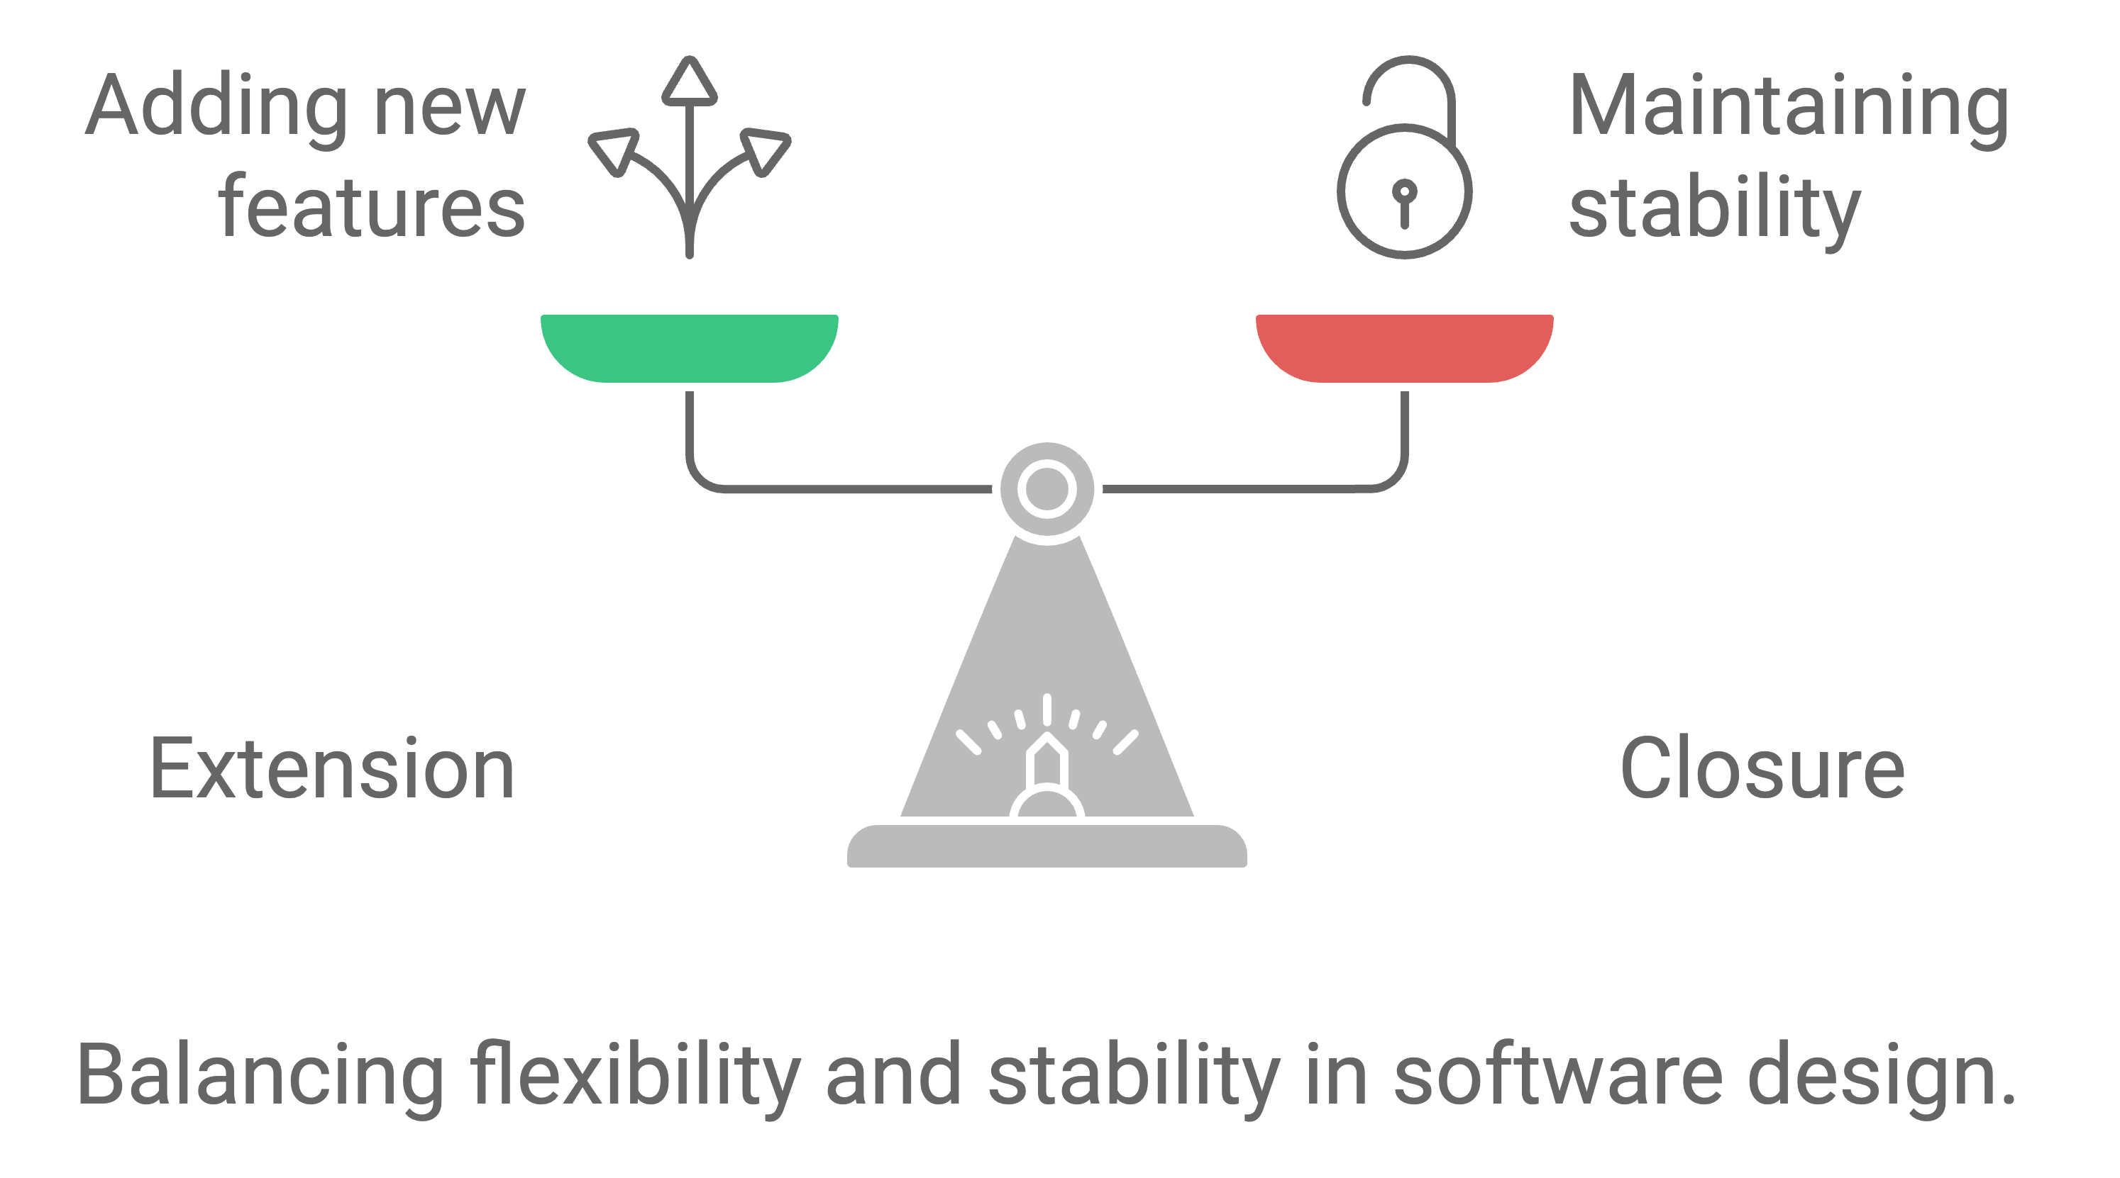
Open-closed principle
Open/Closed Principle (OCP): Software entities (classes, modules, functions, etc.) should be open for extension but closed for modification. This means you should be able to add new functionality without altering existing.
  How to write SOLID code with OCP:
    Use Abstractions: Employ interfaces and abstract classes to define contracts that can be extended without changing the core implementation.

Slide 29
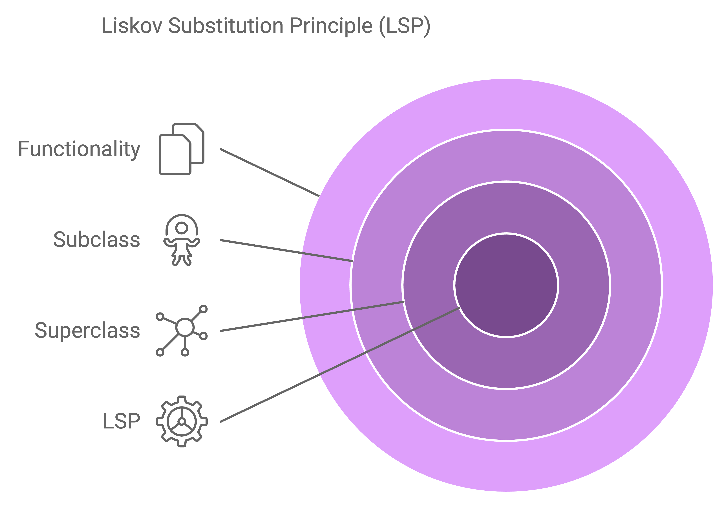
Liskov substitution principle
Liskov Substitution Principle (LSP): Subtypes should be substitutable for their base types without altering the correctness of the program. Derived classes should be usable in any part of the code that expects the base class.
  How to write SOLID code with LSP:
    Ensure Behavior Compatibility: Make sure that subclasses maintain the behavior and contracts defined by their parent classes.

Slide 30
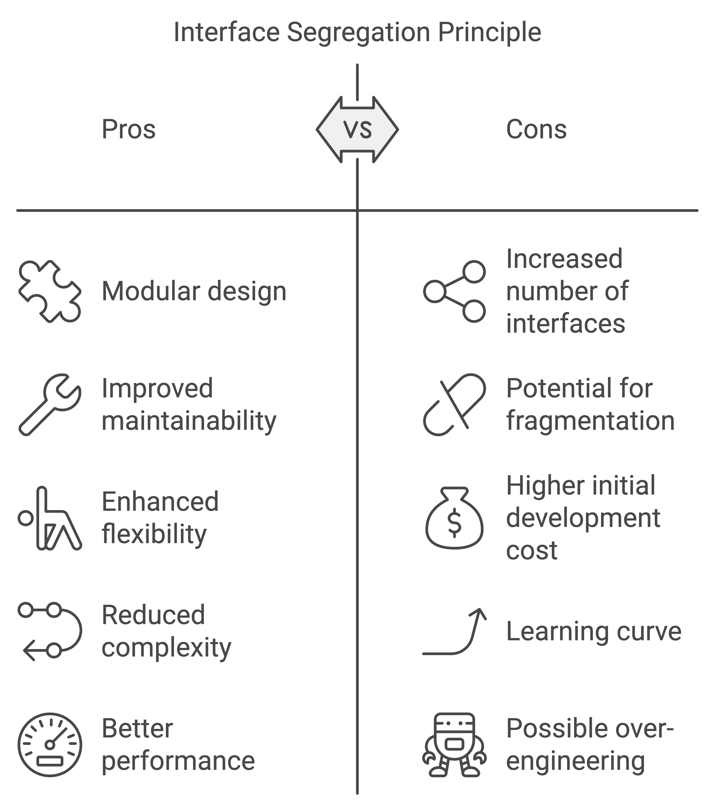
Interface segregation principle
Interface Segregation Principle (ISP): Clients should not be forced to depend on methods they do not use. Break down large interfaces into smaller, more specific interfaces.
  How to write SOLID code with ISP:
    Create Fine-Grained Interfaces: Instead of one large interface with many methods, create multiple smaller interfaces that expose only the necessary methods for specific clients.

Slide 31
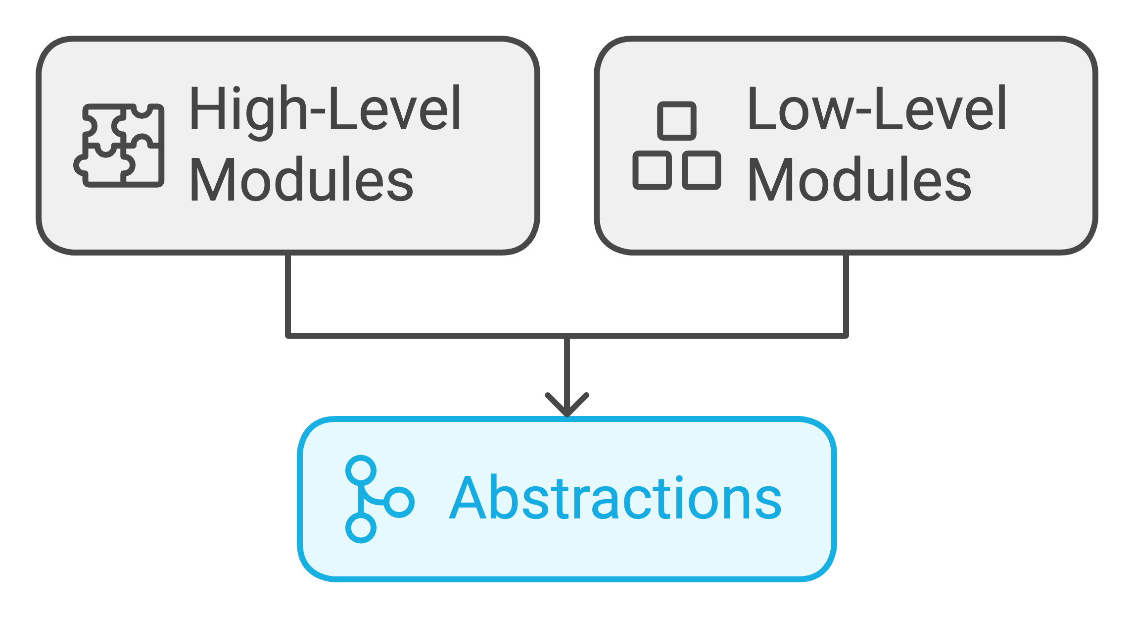
Dependency inversion principle
Dependency Inversion Principle (DIP): High-level modules should not depend on low-level modules. Both should depend on abstractions. Abstractions should not depend on details. Details should depend on abstractions.
  How to write SOLID code with DIP:
    Depend on Interfaces, not Implementations: Use interfaces or abstract classes to define dependencies between modules, rather than directly relying on concrete classes.
In summary, SOLID principles guide you towards writing code that is:
  More understandable: Breaking down complex logic into smaller, focused units.

Slide 32
Side effects and mutability
In computer science, side effects and mutability are related concepts that significantly impact how programs behave and are designed.
Side effects refer to changes to a program's state outside of a function's primary return value, while Mutability indicates whether a data structure can be modified after its creation.
Understanding these concepts is crucial for writing predictable, maintainable, and efficient code.

Slide 33
Side effects and mutability
Side Effects:
  Definition: A side effect is any observable change in a program's state beyond the immediate return value of a function or expression. This includes modifying global variables, altering data passed by reference, performing input/output operations, or raising exceptions.
  Impact: Side effects can make code harder to understand and debug, as the behavior of a function can depend on the order in which it's executed and the current state of the program.
  Examples:
    Modifying a global variable inside a function.
    Changing the contents of a list passed as an argument to a function.
    Writing to a file.
    Printing to the console.

Slide 34
Side effects and mutability
Side Effects: (Cont.)
  Why Avoid Them (Often): Side effects can lead to unexpected behavior, make code harder to test, and introduce subtle bugs, especially in complex systems.
  When They're Necessary: Some operations, like I/O or modifying a shared state, inherently require side effects. In such cases, it's important to manage them carefully and make them as predictable as possible.

Slide 35
Side effects and mutability
Mutability:
  Definition: Mutability refers to the ability of a data structure to be changed after it has been created.
  Impact: Mutable data structures can lead to side effects if not handled carefully. When a function modifies a mutable object passed as an argument, it can affect other parts of the program that also reference that object.
  Examples:
    Lists in Python are mutable.
    Arrays in Java are mutable.
    Objects in many programming languages are mutable by default.

Slide 36
Side effects and mutability
Immutability:
  Immutable Data Structures: In contrast, immutable data structures (like tuples in Python or strings in Java) cannot be modified after creation. Any operation that appears to modify them actually creates a new instance, leaving the original unchanged.
  Benefits of Immutability:
    Reduced Side Effects: Immutability simplifies reasoning about code and reduces the risk of unexpected behavior due to unintended modifications.
    Concurrency: Immutable data structures are inherently thread-safe, making them ideal for concurrent programming.
    Easier Debugging: Debugging becomes easier when you can be sure that a data structure's value remains consistent throughout its lifetime.

Slide 37
Side effects and mutability
Relationship Between Side Effects and Mutability:
  Mutability often leads to side effects. Modifying a mutable object inside a function can cause changes in other parts of the program that share that object.
  Avoiding side effects often involves using immutable data structures or carefully managing mutable data to minimize their impact.
In essence, understanding side effects and mutability is crucial for:
  Writing predictable and maintainable code.
  Developing robust and efficient software.
  Designing systems that are easier to test and debug.

Slide 38
The Builder Pattern
The builder pattern is a creational design pattern that allows for the step-by-step construction of complex objects.
It separates the object's construction logic from its representation, enabling the creation of different representations using the same construction process.
This pattern is particularly useful when an object has numerous optional parameters or when its construction involves multiple steps.

Slide 39
The Builder Pattern
Key Concepts:
  Product: The complex object being built (e.g., a computer, a house, a report).
  Builder: An interface or abstract class that defines the steps for constructing the product.
  ConcreteBuilder: Specific implementations of the Builder interface, each defining a particular way to build the product.
  Director: An optional component that orchestrates the construction process using the builder.
  Client: The code that uses the builder to construct the product.

Slide 40
The Builder Pattern
How it works:
  The client requests a builder object (or is provided with one).
  The client then uses the builder's methods to set various properties or perform steps of the construction process.
  The builder internally builds the product based on the client's instructions.
  Finally, the client retrieves the completed product from the builder.

Slide 41
The Builder Pattern
Benefits:
  Improved code readability: Separates object creation from object usage, making the code cleaner and easier to understand.
  Flexibility and maintainability: Allows for easy addition or modification of construction steps without affecting the client code.
  Reusability: The same builder can be used to create different variations of the product.
  Avoids telescoping constructors: Prevents the need for numerous constructors with different combinations of parameters.
  Supports complex object construction: Enables the creation of objects with numerous optional parameters or a complex construction process.

Slide 42
The Builder Pattern
When to use it:
  When an object has many optional parameters.
  When the object's construction process is complex and involves multiple steps.
  When you need to create different representations of the same object.
  When you want to isolate the object's construction logic from its usage.

Slide 43
Causes of bad code
Bad code can stem from a variety of factors, including poor planning, lack of skills, time pressure, and inadequate testing.
Other contributing elements include code duplication, lack of documentation, and ignoring error handling.
Ultimately, bad code often results from a combination of these issues, leading to increased maintenance costs and potential bugs.

Slide 44
Causes of bad code
Bad code can stem from a variety of factors, including poor planning, lack of skills, time pressure, and inadequate testing.
Other contributing elements include code duplication, lack of documentation, and ignoring error handling.
Ultimately, bad code often results from a combination of these issues, leading to increased maintenance costs and potential bugs.
Next slide will show more detailed breakdown:

Slide 45
Causes of bad code
Lack of Planning and Design:
  Inadequate Research: Not researching available tools, libraries, or improved algorithms can lead to inefficient or poorly structured code.
  Premature Optimization: Trying to optimize code before it's even working can make it harder to understand and maintain.
  Poor Modularization: Not breaking down the code into smaller, manageable parts can lead to a tangled mess as features are added.
  Lack of Clear Requirements: Without a clear understanding of what the code needs to do, it's easy to write code that doesn't meet the actual needs or has bugs.

Slide 46
Causes of bad code
Skills and Knowledge Gaps:
  Insufficient Technical Knowledge: A lack of understanding of programming principles, design patterns, or the specific language can lead to poorly written code.
  Not Recognizing Good vs. Bad Code: Some developers may not be able to identify areas where their code could be improved.
  Inexperience: Beginner developers often make mistakes as they learn, and this can result in bad code.

Slide 47
Causes of bad code
Time and Pressure:
  Meeting Deadlines: Fast-paced projects can lead to developers cutting corners and prioritizing speed over quality.
  Fear of Failure: The pressure to deliver can make developers afraid to refactor or rewrite code, even when it's necessary.
  Delivery Pressure: Prioritizing getting the code working over making it sustainable can lead to bad code.

Slide 48
Causes of bad code
Coding Practices:
  Code Duplication: Repeating the same code in multiple places makes it harder to update and maintain.
  Poor Documentation: Lack of comments and documentation makes it difficult for others (or even the original author) to understand the code.
  Ignoring Error Handling: Not handling potential errors can lead to unexpected crashes and make the code unreliable.
  Hardcoding Values: Embedding specific values directly in the code instead of using variables or constants makes it inflexible.
  Lack of Cohesion: When different parts of the code are not related to each other, it can be difficult to understand and maintain.
  Ignoring Coding Standards: Not following established coding conventions can lead to inconsistent and difficult-to-read code.
  Bad Naming: Using unclear or inconsistent variable and function names makes the code harder to understand.
  Overly Complex Logic: Writing code that is too complex or convoluted makes it harder to debug and maintain.

Slide 49
Causes of bad code
Other Factors:
  Interpersonal Issues: Team dynamics and communication can influence code quality.
  Disinterest or Lack of Motivation: If developers are not invested in the project, they may not put in the effort to write good code.
  Lack of Review Processes: Not having code reviewed by others can lead to errors and bad practices being perpetuated.
  Inertia: Once bad code is written, it can be difficult to fix due to the complexity and the time investment required.

Slide 50
Deadlines
Deadlines/Dead code refers to sections of code within a software program that are never executed or have no impact on the program's functionality.
It's essentially unnecessary code that can be removed without affecting the program's behavior.

Slide 51
Deadlines
Types of Dead Code:
  Unreachable Code: Code that is logically impossible to reach during program execution, often due to conditional statements or control flow structures that prevent it from ever being executed.
  Redundant Code: Code that is executed but whose results are not used or relied upon by any other part of the program.

Slide 52
Deadlines
Why is Dead Code Bad?
  Increased Code Size: Dead code contributes to the overall size of the codebase, making it larger and potentially slower to compile and load.
  Reduced Maintainability: It can make the code harder to understand and modify, as developers might need to spend time figuring out if the code is truly dead or if it serves some hidden purpose.
  Potential for Bugs: Even though it's not executed, dead code can introduce subtle bugs or vulnerabilities if not properly handled during code changes.
  Performance Overhead: In some cases, even though not executed, dead code can still be parsed and processed by the compiler, adding a small amount of overhead.
  Security Implications: Dead code can be a hiding place for malicious code or can be exploited in unexpected ways, especially zombie code.

Slide 53
Deadlines
Examples:
  A block of code after a return statement within a function.
  Code within a conditional branch that is never taken due to flawed logic.
  A function that is defined but never called.
Dead Code Elimination: Tools and techniques exist to automatically identify and remove dead code from a codebase, a process known as dead code elimination. This can significantly improve code quality, maintainability, and potentially performance.

Slide 54
The Broken Window theory
The Broken Window theory, when applied to software development, suggests that neglecting small code issues ("broken windows") can lead to a decline in overall code quality and maintainability, ultimately resulting in more significant problems.
Just as visible signs of disorder in a neighborhood can encourage further neglect and crime, ignoring minor code issues like "code smells" or outdated practices can create a culture where developers feel less motivated to maintain quality, leading to a downward spiral of technical debt and increased bugs.

Slide 55
The Broken Window theory
Core Concept:
  Visible signs of neglect: In software, "broken windows" are things like poorly named variables, inconsistent code styles, duplicated code, or unresolved bugs.
  Downward spiral: If these are left unaddressed, developers may start to believe that quality is not a priority, leading them to tolerate more significant issues and contributing to a decline in overall code health.
  Impact on team culture: A codebase with many "broken windows" can negatively impact developer morale, productivity, and the ability to adapt to change.

Slide 56
The Broken Window theory
Applying the Theory in Refactoring:
  Opportunistic refactoring: Developers should be encouraged to address small issues as they encounter them, rather than waiting for them to become major problems.
  Prioritize code quality: Teams should establish and maintain coding standards and best practices, emphasizing consistency and maintainability.
  Don't ignore "broken windows": Just like a broken window in a building, even small code issues should be addressed promptly. If immediate repair isn't possible, "board them up" by adding comments or TODOs to highlight the problem and prevent further neglect.
  Promote a culture of quality: Encourage developers to take ownership of the code and continuously improve it, fostering a positive feedback loop where good practices are reinforced.

Slide 57
The Broken Window theory
Benefits of Addressing "Broken Windows":
  Improved code quality: Addressing small issues early prevents them from accumulating and becoming major problems.
  Increased developer productivity: A clean and well-maintained codebase is easier to understand and work with, leading to faster development cycles.
  Reduced technical debt: Proactive refactoring helps to keep technical debt under control, preventing it from becoming a major impediment to future development.
  Enhanced team morale: A focus on code quality can boost developer morale and foster a sense of ownership and pride in their work.
In essence, the Broken Window theory in software development highlights the importance of maintaining a high standard of code quality and addressing even minor issues promptly to prevent a decline in overall code health and team culture.

Slide 58
No code review process
A no-code review process, meaning a development workflow that omits code reviews, can have significant negative impacts on software quality and team dynamics.
While it can initially seem faster, it often leads to increased bugs, reduced code quality, knowledge silos, and hinders team learning.

Slide 59
No code review process
Impact of No Code Review Process:
  Reduced Code Quality and Increased Bugs: Code reviews are crucial for identifying errors, inconsistencies, and potential security vulnerabilities that might be missed during individual development. Without this, the codebase is more likely to contain bugs, leading to increased technical debt and potentially serious issues in production.
  Knowledge Silos: Code reviews facilitate knowledge sharing among developers. When code is not reviewed, developers may not be aware of changes made by others, leading to a lack of understanding of the codebase and potential conflicts when integrating different parts of the system.
  Hindered Team Learning: Code reviews offer a valuable opportunity for developers to learn from each other's code, best practices, and problem-solving approaches. Without them, team members may miss out on learning opportunities, hindering their professional growth and the overall skill level of the team.

Slide 60
No code review process
Impact of No Code Review Process
  Increased Risk of Security Vulnerabilities: Code reviews play a vital role in identifying security flaws. Without this layer of scrutiny, the software becomes more vulnerable to attacks and data breaches.
  Slower Time to Resolution: While code reviews can initially add time to the development cycle, they often prevent time-consuming debugging and rework later on. A lack of code review can lead to more time spent on fixing production issues and addressing problems that could have been avoided.
  Erosion of Team Cohesion: Code reviews foster a sense of collaboration and shared responsibility for the codebase. The absence of this process can lead to a lack of communication and trust among team members, potentially creating tension and hindering teamwork.
  Loss of Institutional Knowledge: When developers leave a project or company without proper code documentation and knowledge sharing, valuable insights and understanding of the codebase can be lost.

Slide 61
No code review process
Why Code Reviews Matter?:
  Early Bug Detection: Code reviews help catch errors early in the development process, preventing them from propagating into later stages and potentially reaching production.
  Improved Code Style and Readability: Reviews ensure that code adheres to established coding standards and best practices, improving its readability and maintainability.
  Knowledge Sharing and Skill Development: Reviews allow developers to learn from each other's code and techniques, fostering a culture of continuous learning and improvement within the team.
  Enhanced Collaboration: Code reviews encourage communication and collaboration among team members, fostering a more cohesive and efficient development environment.
  Reduced Technical Debt: By identifying and addressing potential issues early on, code reviews help minimize the accumulation of technical debt, making the codebase more sustainable in the long run.

Slide 62
No code review process
In conclusion, while a no-code review process might seem appealing for speed and efficiency, it is crucial to recognize the significant risks associated with it.
Prioritizing code reviews, even in agile environments, is essential for maintaining high-quality code, fostering a strong team dynamic, and ensuring long-term project success.

Slide 63
Insufficient domain or technical knowledge
Insufficient domain or technical knowledge in software development can lead to a variety of negative consequences, including poorly designed solutions, wasted time and resources, increased development time, and ultimately, project failure.
A lack of domain knowledge can result in focusing on the wrong aspects of a problem or creating solutions that don't fully meet user needs.
Similarly, insufficient technical knowledge can lead to inefficient code, security vulnerabilities, and difficulty in maintaining and scaling the software.

Slide 64
Insufficient domain or technical knowledge
Consequences of Insufficient Domain Knowledge:
  Poorly Designed Solutions: Without a strong understanding of the problem domain, developers may create solutions that are not well-suited to the specific needs of the users or the business. This can lead to features that are not used, or worse, features that cause more problems than they solve.
  Wasted Time and Resources: Time and effort may be spent on developing features that are not needed or on optimizing aspects of the software that are not performance bottlenecks. This can result in overruns in both time and budget.
  Inaccurate Estimates: Lack of domain knowledge can make it difficult to accurately estimate the time and resources required for a project, leading to unrealistic deadlines and potential project delays.
  Difficulty in Communication: When developers lack domain knowledge, communication with stakeholders can be challenging. This can lead to misunderstandings and disagreements about requirements and functionality.
  Increased Risk of Project Failure: All of the above factors can contribute to an increased risk of project failure, including missed deadlines, budget overruns, and ultimately, a product that does not meet the needs of the users.

Slide 65
Insufficient domain or technical knowledge
Consequences of Insufficient Technical Knowledge:
  Inefficient Code: Developers may write code that is not optimized for performance, leading to slow execution and increased resource consumption.
  Security Vulnerabilities: Lack of technical knowledge can result in the introduction of security vulnerabilities into the software, making it susceptible to attacks.
  Difficulties in Maintenance and Scaling: Poorly written code and a lack of understanding of the underlying technology can make it difficult to maintain and scale the software as the project evolves.
  Increased Development Time: Inefficient coding practices and the need to refactor code due to technical shortcomings can significantly increase development time.
  Technical Debt: Poor technical decisions early in the project can lead to technical debt, which is the cost of rework in the future. .

